Slide 1







<M6 Capstone Project>
<Rohit Nair>
<20th October 2023>

Slide 2

OUTLINE
Executive Summary
Introduction
Methodology
Results
Visualization – Charts
Dashboard
Discussion
Findings & Implications
Conclusion
Appendix

Slide 3

EXECUTIVE SUMMARY
To excel in software development, it's crucial to explore the evolving technological landscape, emphasizing the importance, popularity, and expected changes. This knowledge is fundamental for staying relevant and effective.
Furthermore, we need to delve into the shifting trends in database technologies and data management strategies, as data plays a central role in our increasingly data-driven world.
In the realm of web frameworks and platforms, obtaining a comprehensive understanding of the continually changing environment is invaluable for strategically creating and launching web-based solutions that can adapt to the dynamic demands of the digital marketplace.

Slide 4

INTRODUCTION
Analysing different platforms used for different things.
Coding language trends.
Database trends.
Such analysis is important to keep up with tech trends and incline forward accordingly.

Slide 5

METHODOLOGY
Databases
Data from service providers
Coding Platforms
Software purchases

Slide 6
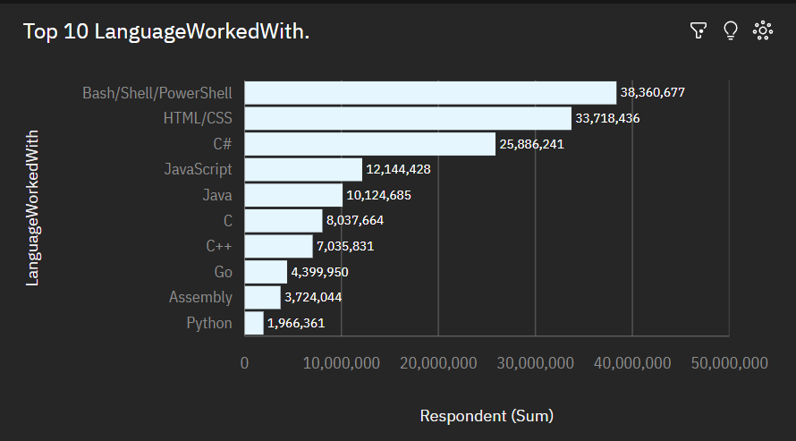
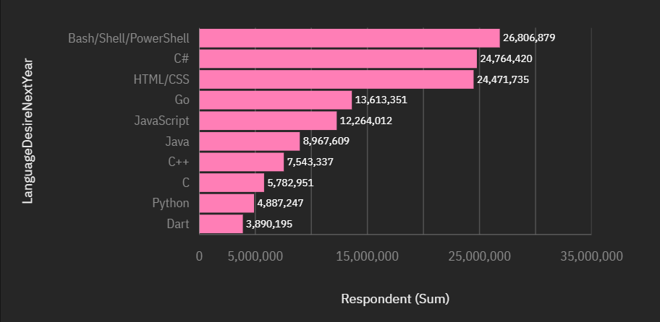
PROGRAMMING LANGUAGE TRENDS
Current Year
Next Year

Slide 7
PROGRAMMING LANGUAGE TRENDS - FINDINGS & IMPLICATIONS
Findings
C# more popular then C++ or Python
Java most popular language
Implications
Software development leaning interests
Web development learners
Basics over better

Slide 8
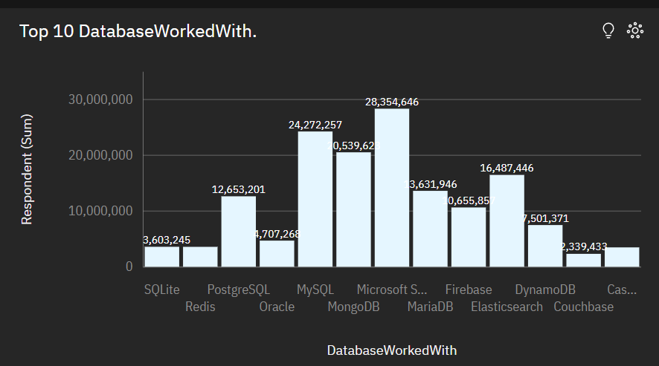
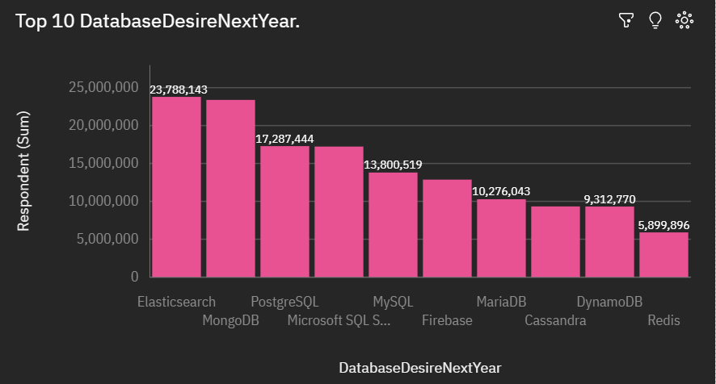
DATABASE TRENDS
Current Year
Next Year

Slide 9
DATABASE TRENDS - FINDINGS & IMPLICATIONS
Findings
SQL remains prominent
MongoDB rising
Implications
Oracle keeps data base monopoly with SQL
Python and Cassandra getting more popular with people

Slide 10

DASHBOARD
https://eu2.ca.analytics.ibm.com/bi/?perspective=dashboard&pathRef=.my_folders%2FM5%2BDashboard%2BCapstone%2BProject&action=view&mode=dashboard&subView=model0000018b4d31f193_00000001

Slide 11
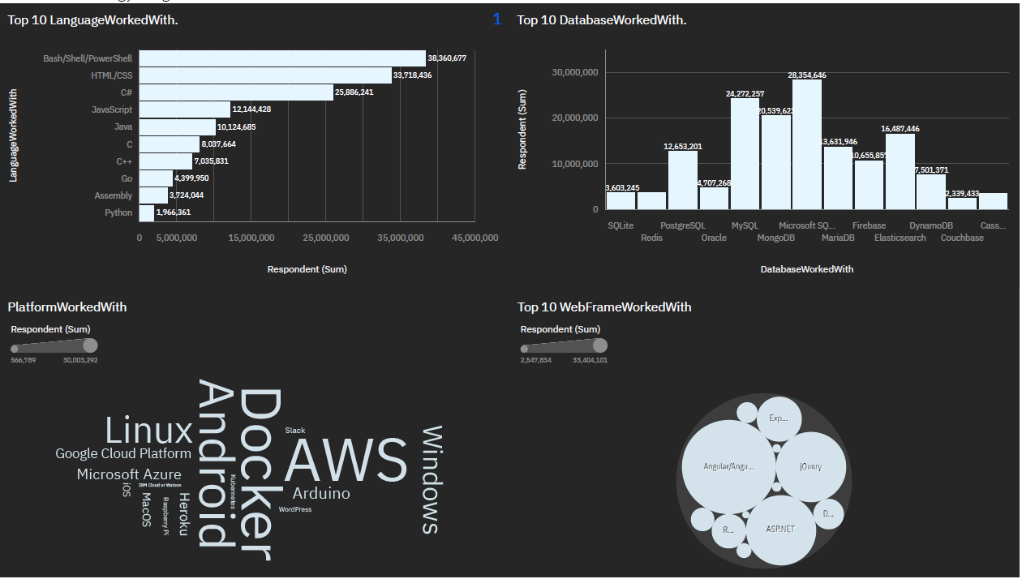
Current Technology Usage

Slide 12
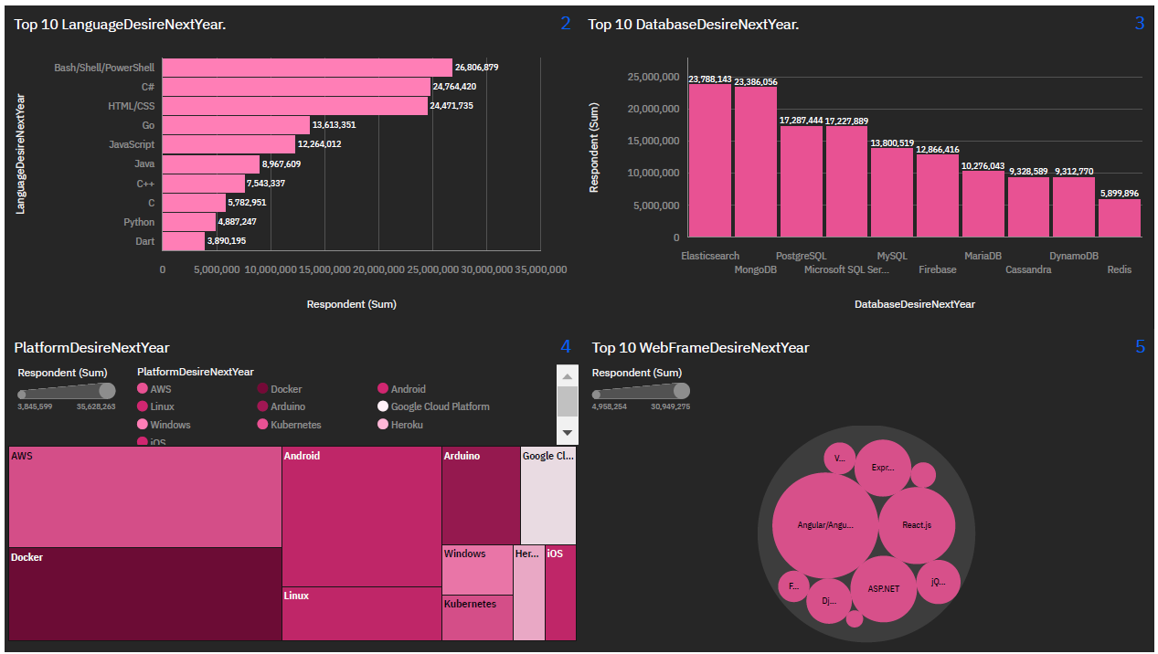
Future Technology Trend

Slide 13
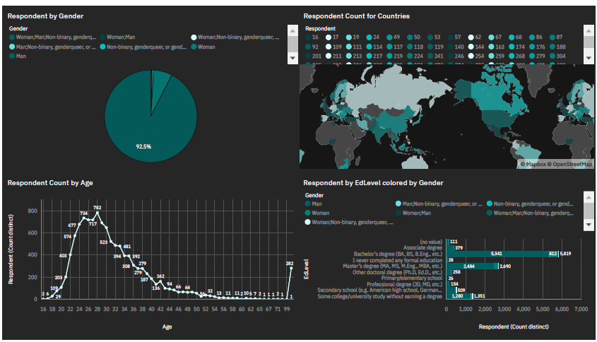
Demographics

Slide 14
DISCUSSION

Slide 15
OVERALL FINDINGS & IMPLICATIONS
Findings
The top 5 web frames gaining popularity are React.js, Angular.js, Vue.js, ASP.NET, jQuery and Express
Implications
Continue employment of staff skilled in JavaScript and HTML/CSS but increase employment in people skilled in TypeScript and

Slide 16

CONCLUSION
Prepare budget accordingly
Plan future products accordingly

Slide 17
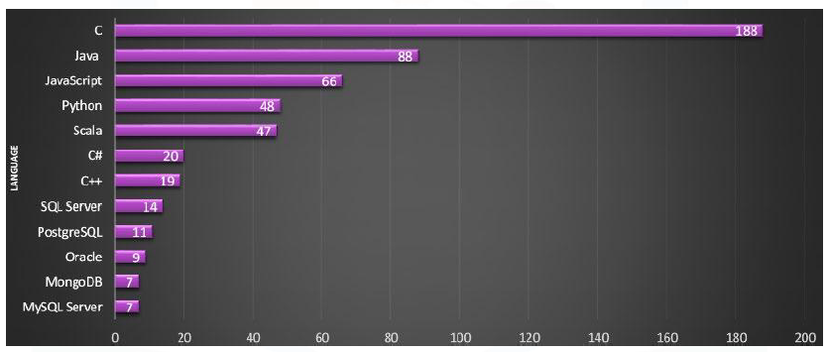
JOB POSTINGS

Slide 18
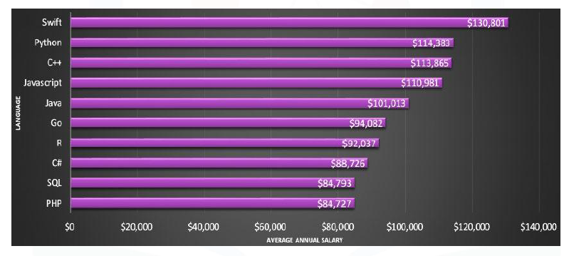
POPULAR LANGUAGES

